Slide 1
HTML5

Slide 2
Content
HTML Links
HTML Tables
HTML Lists

Slide 3
HTML Links
Links are found in nearly all web pages. Links allow users to click their way from page to page.
HTML links are hyperlinks.
You can click on a link and jump to another document.
When you move the mouse over a link, the mouse arrow will turn into a little hand.
A link does not have to be text.
A link can be an image or any other HTML element
The HTML <a> tag defines a hyperlink. It has the following syntax:
<a href="url">link text</a>
The most important attribute of the <a> element is the href attribute, which indicates the link's destination.
The link text is the part that will be visible to the reader.
Clicking on the link text, will send the reader to the specified URL address.

Slide 4
HTML Links
By default, links will appear as follows in all browsers:
An unvisited link is underlined and blue
A visited link is underlined and purple
An active link is underlined and red
Links can be styled with CSS, to get another look
By default, the linked page will be displayed in the current browser window.
To change this, specify another target for the link.
The target attribute specifies where to open the linked document.
The target attribute can have one of the following values:
_self - Default. Opens the document in the same window/tab as it was clicked
_blank - Opens the document in a new window or tab
_parent - Opens the document in the parent frame
_top - Opens the document in the full body of the window
<!DOCTYPE html> <html lang = "en-US"> <head> <title>Link</title> </head> <body>
<a href="https://www.w3schools.com/">Visit W3Schools.com!</a>
<a href="https://www.w3schools.com/" target="_blank">Visit W3Schools!</a>
</body>
</html>

Slide 5
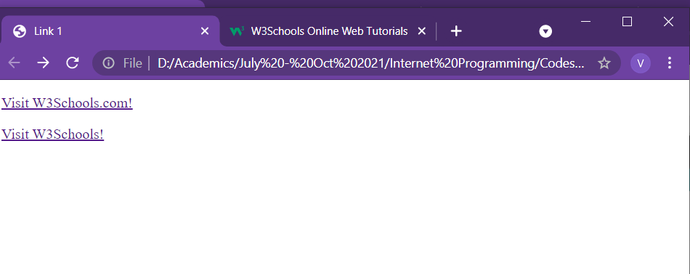
HTML Links
<!DOCTYPE html> <html lang = "en-US"> <head> <title>Link</title> </head> <body>
<a href="https://www.w3schools.com/">Visit W3Schools.com!</a>
<a href="https://www.w3schools.com/" target="_blank">Visit W3Schools!</a>
</body>
</html>

Slide 6
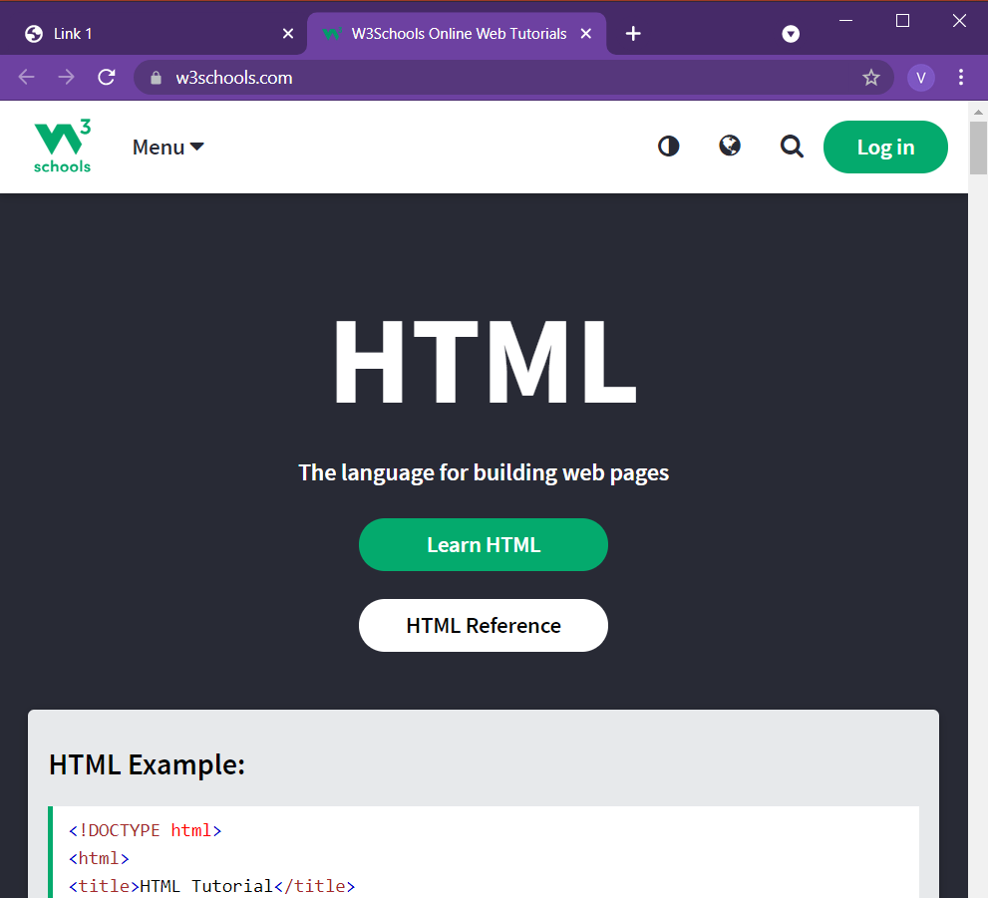
HTML Links
<!DOCTYPE html> <html lang = "en-US"> <head> <title>Link</title> </head> <body>
<a href="https://www.w3schools.com/">Visit W3Schools.com!</a>
<a href="https://www.w3schools.com/" target="_blank">Visit W3Schools!</a>
</body>
</html>

Slide 7
HTML Links
<!DOCTYPE html> <html lang = "en-US"> <head> <title>Link 2</title> </head> <body>
<h2>Absolute URLs</h2> <p><a href="https://www.w3.org/">W3C</a></p> <p><a href="https://www.google.com/">Google</a></p> <h2>Relative URLs</h2> <p><a href="html_images.asp">HTML Images</a></p> <p><a href="/css/default.asp">CSS Tutorial</a></p>
</body>
</html>
Absolute and Relative URL
Absolute URL: Full web address in the href attribute
Relative URL: A local link – page within the same website

Slide 8
HTML Links
<!DOCTYPE html> <html lang = "en-US"> <head> <title>Link 2</title> </head> <body>
<a href="default.asp"> <img src="smiley.jpeg" alt="HTML tutorial" style="width:42px;height:42px;"> </a>
<a href="mailto:someone@example.com">Send email</a>
<button onclick="document.location='default.asp’”>Formatting Page</button>
</body>
</html>
Use an Image as a link
To use an image as a link, just put the <img> tag inside the <a> tag
Link to an Email Address
Use mailto: inside the href attribute to create a link that opens the user's email program (to let them send a new mail)
Button as a link
JavaScript allows you to specify what happens at certain events, such as a click of a button

Slide 9
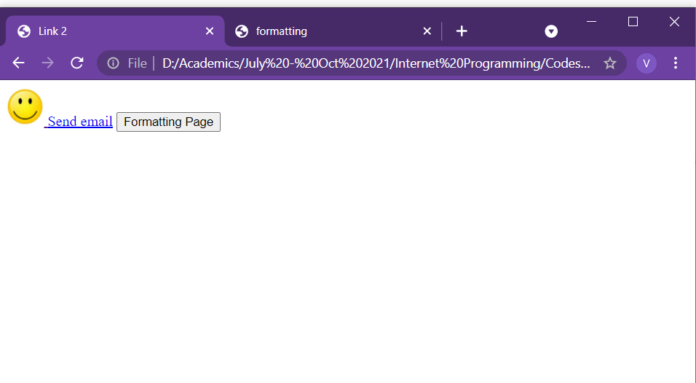
HTML Links
<!DOCTYPE html> <html lang = "en-US"> <head> <title>Link 2/title> </head> <body>
<a href="default.asp"> <img src="smiley.jpeg" alt="HTML tutorial" style="width:42px;height:42px;"> </a>
<a href="mailto:someone@example.com">Send email</a>
<button onclick="document.location='default.asp’”>Formatting Page</button>
</body>
</html>

Slide 10
HTML Tables
<!DOCTYPE html> <html lang = "en-US"> <head> <title>Table</title> </head> <body>
<table style="width:100%"> <tr> <th>Firstname</th> <th>Lastname</th> <th>Age</th> </tr> <tr> <td>Suresh</td> <td>Kumar</td> <td>50</td> </tr> <tr> <td>Nageshwar</td> <td>Rao</td> <td>65</td> </tr> </table>
</body>
</html>
It allows web developers to arrange data into rows and columns
<table> tag: defines an HTML table.
<tr> tag: It defines row in the table
<th> tag: It defines table header
<td> tag: It defines table data/cell
By default, the text in <th> elements are bold and centered.
By default, the text in <td> elements are regular and left-aligned.

Slide 11
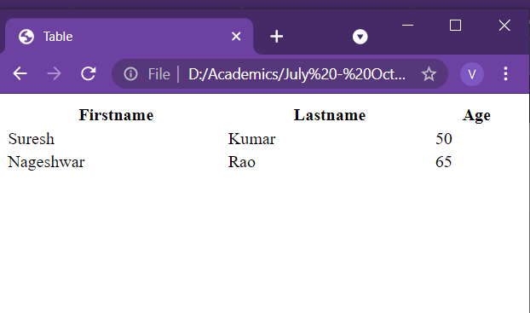
HTML Tables
<!DOCTYPE html> <html lang = "en-US"> <head> <title>Table</title> </head> <body>
<table> <tr> <th>Firstname</th> <th>Lastname</th> <th>Age</th> </tr> <tr> <td>Suresh</td> <td>Kumar</td> <td>50</td> </tr> <tr> <td>Nageshwar</td> <td>Rao</td> <td>65</td> </tr> </table>
</body>
</html>

Slide 12
HTML Tables
Border for Table
To add a border to a table, use the CSS border property
Put the following code in head tag
<style>
table, th, td {
border: 1px solid black;
}
</style>
<!DOCTYPE html> <html lang = "en-US"> <head> <title>Table</title>
<style>
table, th, td { border: 1px solid black; }
</style>
</head> <body>
<table> <tr> <th>Firstname</th> <th>Lastname</th> <th>Age</th> </tr> <tr> <td>Suresh</td> <td>Kumar</td> <td>50</td> </tr> <tr> <td>Nageshwar</td> <td>Rao</td> <td>65</td> </tr> </table>
</body>
</html>

Slide 13
HTML Tables
Collapsed Border
To let the borders collapse into one border, add the CSS border-collapse property:
<style>
table, th, td {
border: 1px solid black;
border-collapse: collapse;
}
</style>
<!DOCTYPE html> <html lang = "en-US"> <head> <title>Table</title>
<style>
table, th, td { border: 1px solid black;
border-collapse: collapse; }
</style>
</head> <body>
<table> <tr> <th>Firstname</th> <th>Lastname</th> <th>Age</th> </tr> <tr> <td>Suresh</td> <td>Kumar</td> <td>50</td> </tr> <tr> <td>Nageshwar</td> <td>Rao</td> <td>65</td> </tr> </table>
</body>
</html>

Slide 14
HTML Tables
Cell Padding
Cell padding specifies the space between the cell content and its borders.
If padding is not specified, the table cells will be displayed without padding.
To set the padding, use the CSS padding property:
th, td {
padding: 15px;
}
Left Align Headings
By default, table headings are bold and centered.
To left-align the table headings, use the CSS text-align property:
th {
text-align: left;
}
Border Spacing
Border spacing specifies the space between the cells.
If the table has collapsed borders, border-spacing has no effect.
To set the border spacing for a table, use the CSS border-spacing property:
table {
border-spacing: 5px;
}
<!DOCTYPE html> <html lang = "en-US"> <head> <title>Table</title>
<style>
table, th, td { border: 1px solid black;
border-collapse: collapse; }
th, td { padding: 15px; }
</style>
</head> <body>
<table> <tr> <th>Firstname</th> <th>Lastname</th> <th>Age</th> </tr> <tr> <td>Suresh</td> <td>Kumar</td> <td>50</td> </tr> <tr> <td>Nageshwar</td> <td>Rao</td> <td>65</td> </tr> </table>
</body>
</html>

Slide 15
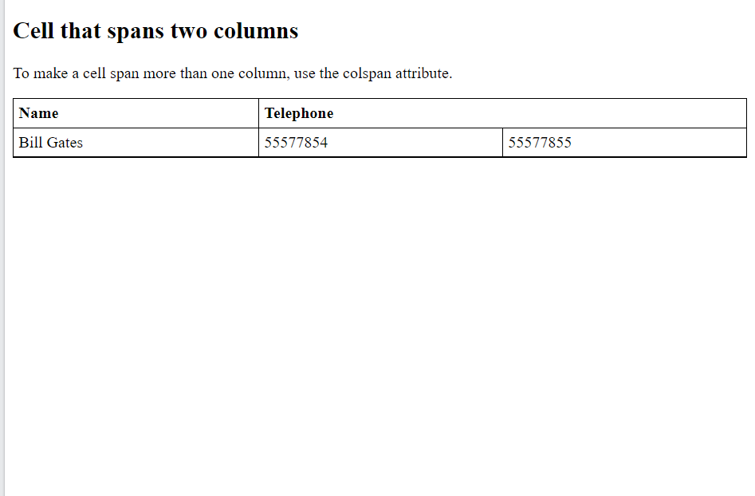
HTML Tables
<!DOCTYPE html> <html lang = "en-US"> <head> <title>Table</title>
<style>
table, th, td { border: 1px solid black;
border-collapse: collapse; }
th, td { padding: 5px;
text-align: left; }
</style>
</head> <body>
<table style="width:100%"> <tr> <th>Name</th> <th colspan="2">Telephone</th> </tr> <tr> <td>Bill Gates</td> <td>55577854</td> <td>55577855</td> </tr> </table>
</body>
</html>
Cell that spans many columns
To make a cell span more than one column, use the colspan attribute:

Slide 16
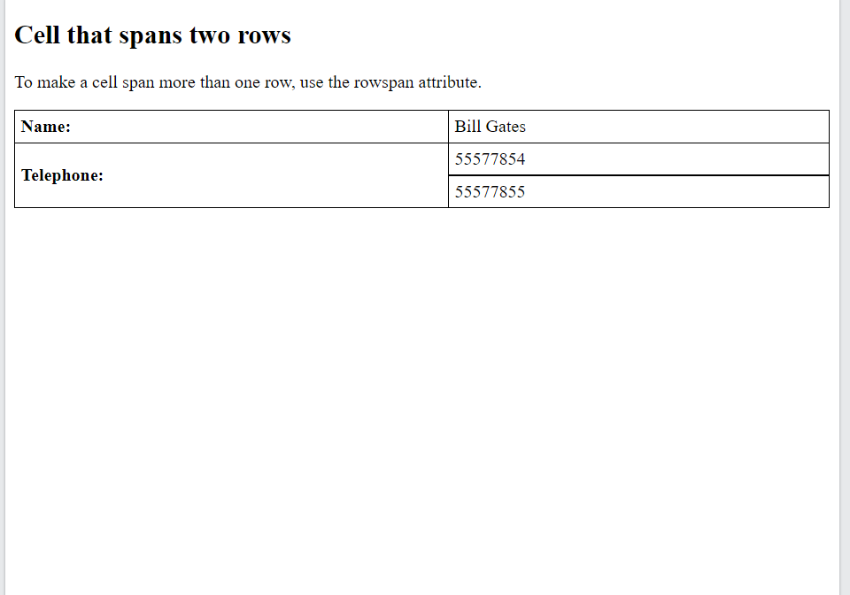
HTML Tables
<!DOCTYPE html> <html lang = "en-US"> <head> <title>Table</title>
<style>
table, th, td { border: 1px solid black;
border-collapse: collapse; }
th, td { padding: 5px;
text-align: left; }
</style>
</head> <body>
<table style="width:100%"> <tr> <th>Name:</th> <td>Bill Gates</td> </tr> <tr> <th rowspan="2">Telephone:</th> <td>55577854</td> </tr> <tr> <td>55577855</td> </tr> </table>
</body>
</html>
Cell that spans many rows
To make a cell span more than one column, use the rowspan attribute

Slide 17
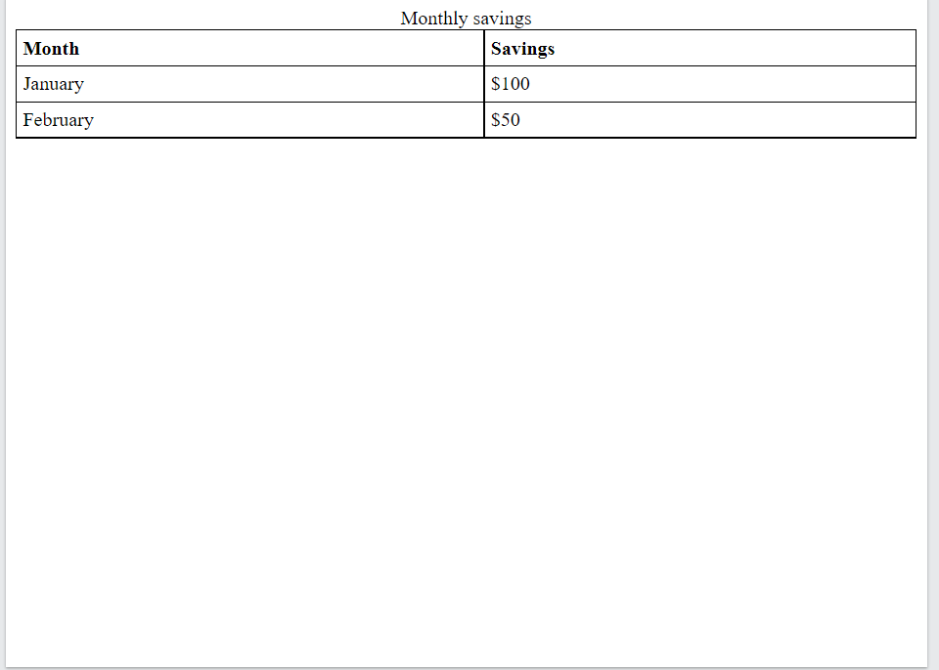
HTML Tables
<!DOCTYPE html> <html lang = "en-US"> <head> <title>Table</title>
<style>
table, th, td { border: 1px solid black;
border-collapse: collapse; }
th, td { padding: 5px;
text-align: left; }
</style>
</head> <body>
<table style="width:100%"> <caption>Monthly savings</caption> <tr> <th>Month</th> <th>Savings</th> </tr> <tr> <td>January</td> <td>$100</td> </tr> <tr> <td>February</td> <td>$50</td> </tr> </table>
</body>
</html>
Caption for the table
Use <caption> tag to add caption for table

Slide 18
HTML Lists
HTML lists allow web developers to group a set of related items in lists.
There are three types
Unordered lists
Ordered lists
Other lists

Slide 19
HTML Lists
Unordered list
An unordered list starts with the <ul> tag.
Each list item starts with the <li> tag.
The list items will be marked with bullets (small black circles) by default
The CSS list-style-type property is used to define the style of the list item marker.
It can have one of the following values:
Value Description
disc Sets the list item marker to a bullet (default)
circle Sets the list item marker to a circle
square Sets the list item marker to a square
none The list items will not be marked
<!DOCTYPE html> <html lang = "en-US"> <head> <title>List</title>
</head> <body>
<ul> <li>Coffee</li> <li>Tea</li> <li>Milk</li> </ul>
<ul style="list-style-type:disc;"> <li>Coffee</li> <li>Tea</li> <li>Milk</li> </ul>
<ul style="list-style-type:none;"> <li>Coffee</li> <li>Tea</li> <li>Milk</li> </ul>
</body>
</html>

Slide 20
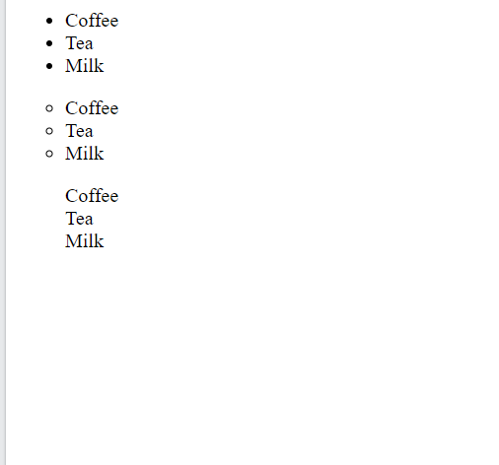
HTML Lists
<!DOCTYPE html> <html lang = "en-US"> <head> <title>List</title>
</head> <body>
<ul> <li>Coffee</li> <li>Tea</li> <li>Milk</li> </ul>
<ul style="list-style-type:disc;"> <li>Coffee</li> <li>Tea</li> <li>Milk</li> </ul>
<ul style="list-style-type:none;"> <li>Coffee</li> <li>Tea</li> <li>Milk</li> </ul>
</body>
</html>

Slide 21
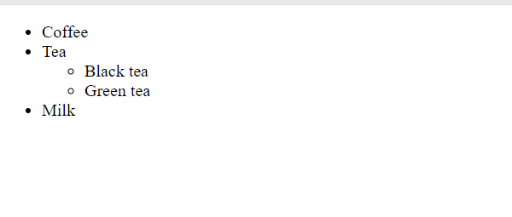
HTML Lists
<!DOCTYPE html> <html lang = "en-US"> <head> <title>List</title>
</head> <body>
<ul> <li>Coffee</li> <li>Tea <ul> <li>Black tea</li> <li>Green tea</li> </ul> </li> <li>Milk</li> </ul>
</body>
</html>
Nested list
Lists can be nested

Slide 22
HTML Lists
Ordered list
The HTML <ol> tag defines an ordered list.
An ordered list can be numerical or alphabetical.
An ordered list starts with the <ol> tag.
Each list item starts with the <li> tag.
The list items will be marked with numbers by default
The type attribute of the <ol> tag, defines the type of the list item marker:
Type Description
type="1" The list items will be numbered with numbers (default)
type="A" The list items will be numbered with uppercase letters
type="a" The list items will be numbered with lowercase letters
type="I" The list items will be numbered with uppercase roman numbers
type="i" The list items will be numbered with lowercase roman numbers
<!DOCTYPE html> <html lang = "en-US"> <head> <title>List</title>
</head> <body>
<ol> <li>Coffee</li> <li>Tea</li> <li>Milk</li> </ol>
<ol type="A"> <li>Coffee</li> <li>Tea</li> <li>Milk</li> </ol>
<ol type="I"> <li>Coffee</li> <li>Tea</li> <li>Milk</li> </ol>
</body>
</html>

Slide 23
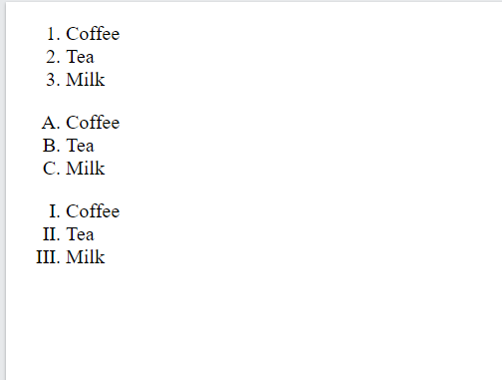
HTML Lists
<!DOCTYPE html> <html lang = "en-US"> <head> <title>List</title>
</head> <body>
<ol> <li>Coffee</li> <li>Tea</li> <li>Milk</li> </ol>
<ol type="A"> <li>Coffee</li> <li>Tea</li> <li>Milk</li> </ol>
<ol type="I"> <li>Coffee</li> <li>Tea</li> <li>Milk</li> </ol>
</body>
</html>

Slide 24
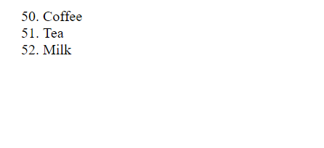
HTML Lists
<!DOCTYPE html> <html lang = "en-US"> <head> <title>List</title>
</head> <body>
<ol start="50"> <li>Coffee</li> <li>Tea</li> <li>Milk</li> </ol>
</body>
</html>
Control List counting
By default, an ordered list will start counting from 1.
If counting has to be started from a specified number, use the start attribute

Slide 25
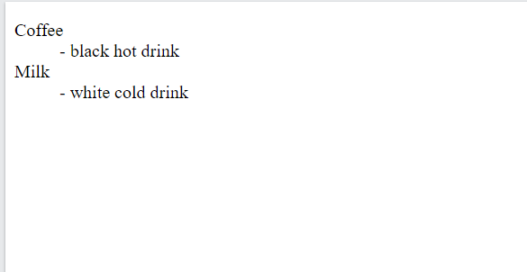
HTML Lists
Description list
A description list is a list of terms, with a description of each term.
The <dl> tag defines the description list
The <dt> tag defines the term (name)
The <dd> tag describes each term
<!DOCTYPE html> <html lang = "en-US"> <head> <title>List</title>
</head> <body>
<dl> <dt>Coffee</dt> <dd>- black hot drink</dd> <dt>Milk</dt> <dd>- white cold drink</dd> </dl>
</body>
</html>

